Slide 1
Homework 8 (Discussion)
Plot the time series of Kuroshio speeds at the stations:
M1: 90m, 190m and 290m
M3: 100m, 200m and 400 m
(as shown in Page 31)
Paste the figure of the speed time series into a word file.
Observe the time series carefully.
Where and when the Kuroshio has a faster and slower speed, and, where and when the Kuroshio has a higher and smaller vibrations?

Slide 2
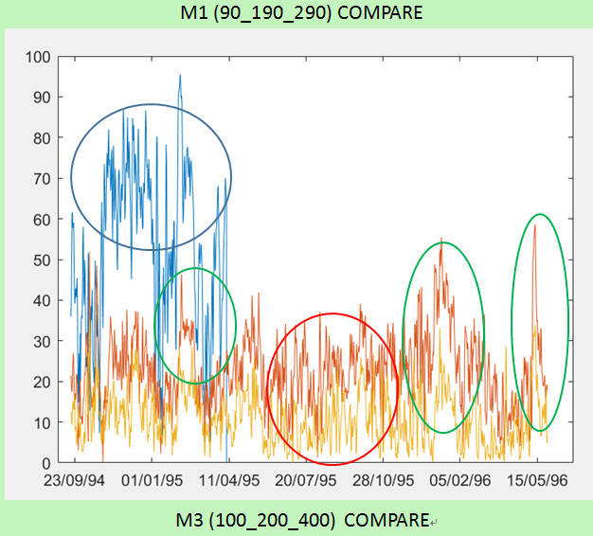
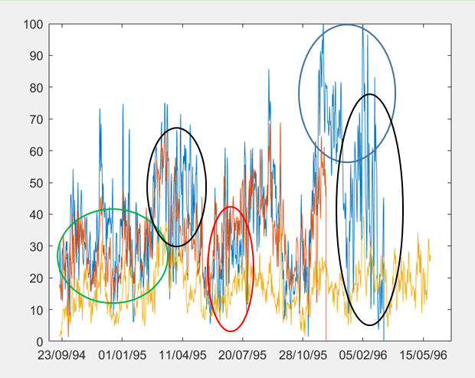
Where and when the Kuroshio has a faster and slower speed, and, where and when the Kuroshio has a higher and smaller vibrations?

Slide 3
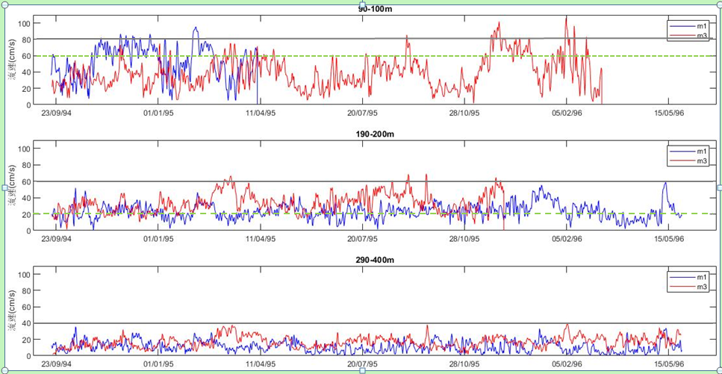

Slide 4
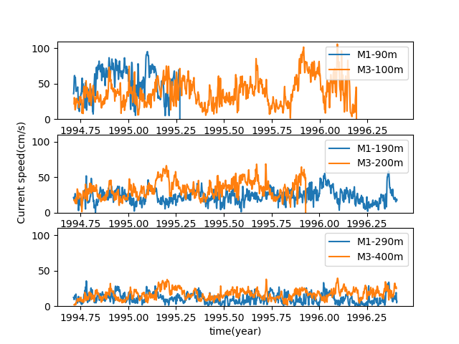
在M3測站水深100M處的1996年2月有最高的流速
在M1測站水深290M處的1995年6月和1996年3月有最低的流速
在M3測站水深100M處的1996年1~2月有最大的震盪
在M1測站水深290M處的1995年6~7月有最小的震盪

Slide 5
各層流速之平均質:
average | m3 100 | m3 200 | m3 400 | m1 90 | m1 190 | m1 290
 | 39.0304 | 33.3234 | 16.82845 | 52.71674 | 23.04173 | 11.02945
各層流速之標準差:
standard deviation | m3 100 | m3 200 | m3 400 | m1 90 | m1 190 | m1 290
 | 18.84618 | 11.88706 | 6.710057 | 20.17875 | 9.186369 | 6.472007

Slide 6
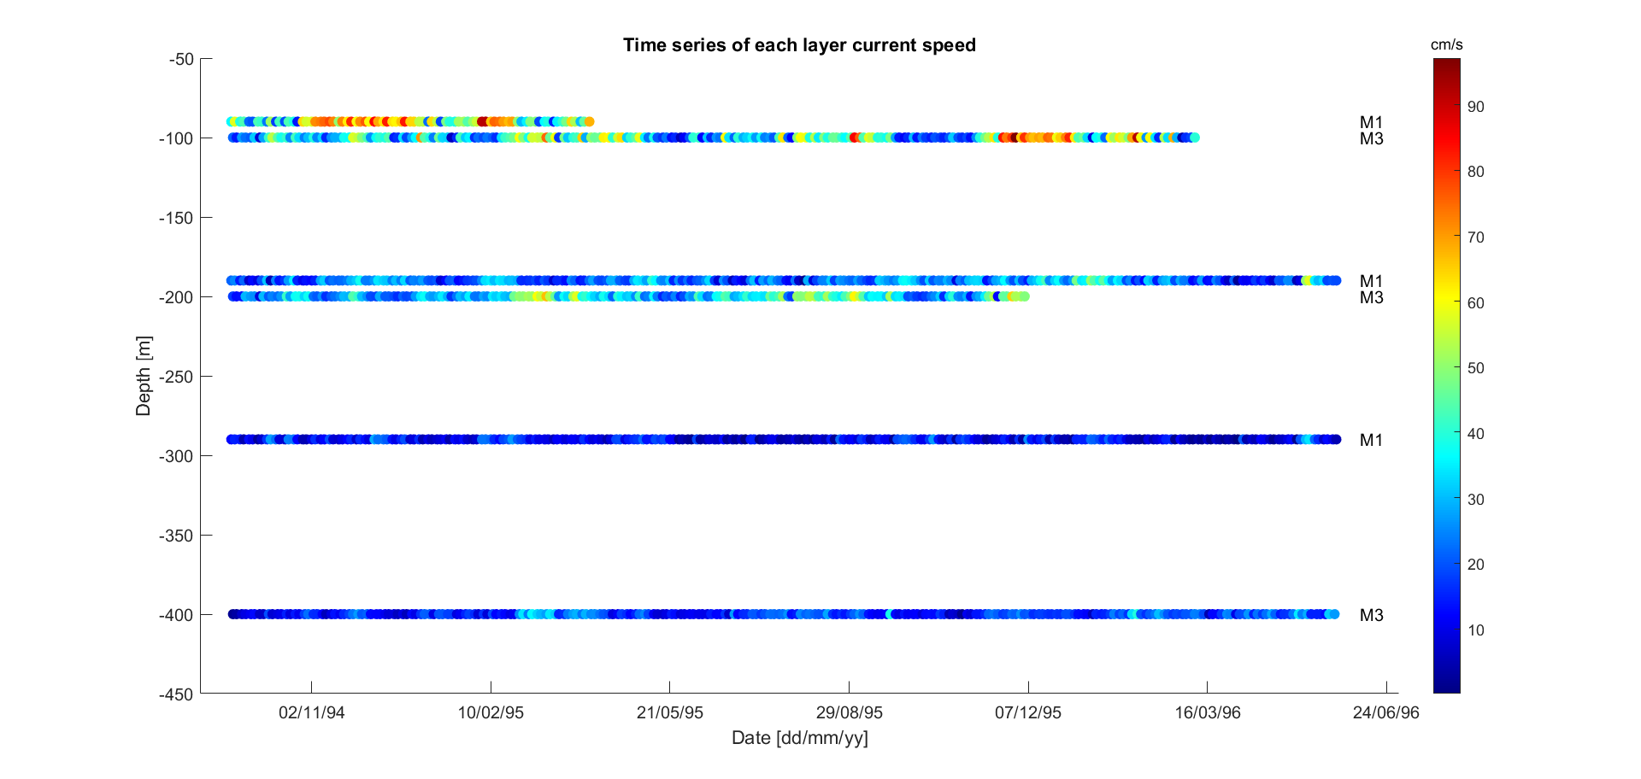

Slide 7
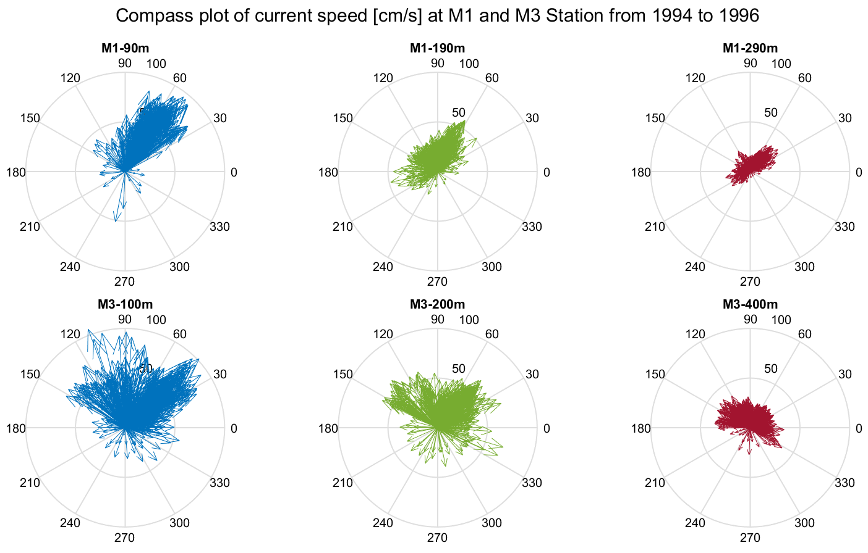
由這張圖可以看出測站所測得的海流流向大多數都往東北方前進，與黑潮的流向大致符合，藍色、綠色及紅色分別對應淺層、中層及深層海流流速；而仔細觀察可以看出在M1測站所測得的海流流向較為一致，在M3測站則較為分散；同時也能看出不同層的流速有所變化，越往深層流速越低。

Slide 8
Wind-driven Circulation(I): Geostrophic Currents
From Satellite Altimeters

Slide 9
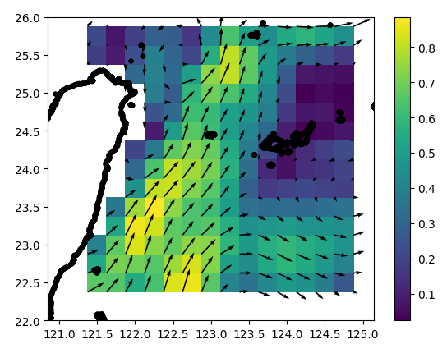
The figure to be plotted today

Slide 10
What are geostrophic currents (REVIEW)
What are geostrophic currents?
Why does Kuroshio flow against winds although it is a wind-driven current?

Slide 11
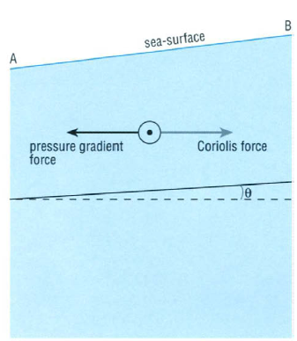
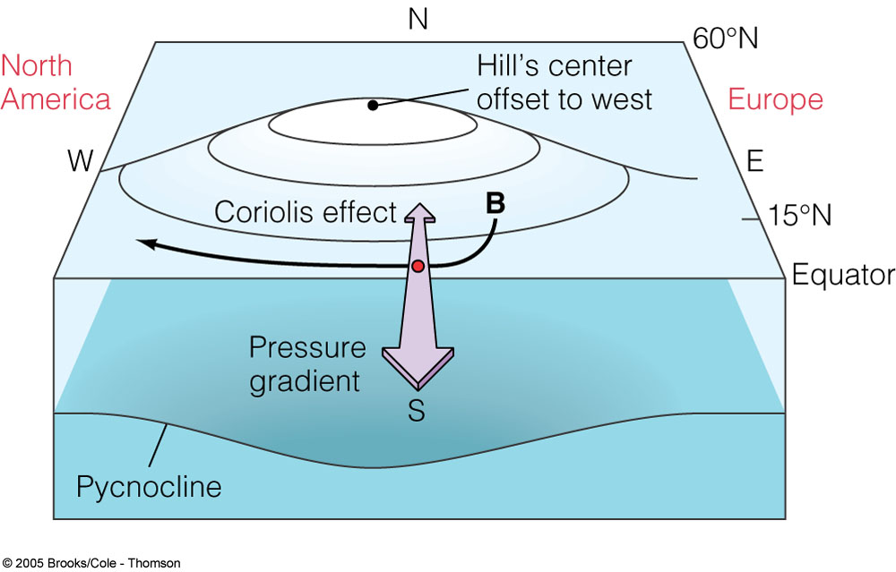
Geostrophic Currents (REVIEW)
pressure gradients force = Coriolis force
(The balance between pressure gradients force and Coriolis Force)

Slide 12
The Equations of Geostrophic Currents (REVIEW)
Basic Idea:
1) Balance between pressure-gradient force and Coriolis force
2) Current velocities are proportional to pressure gradients
What so important about this link or balance?
The equation is just like different languages.

Slide 13
The equations of today
h: sea surface height
f: Coriolis parameter (2*omega*sin(lat))
g: 9.8 m/s²
x and y: longitude and latitude
We can use these equations to calculate the Kuroshio velocities at the ocean surface, if we have the sea surface height data

Slide 14
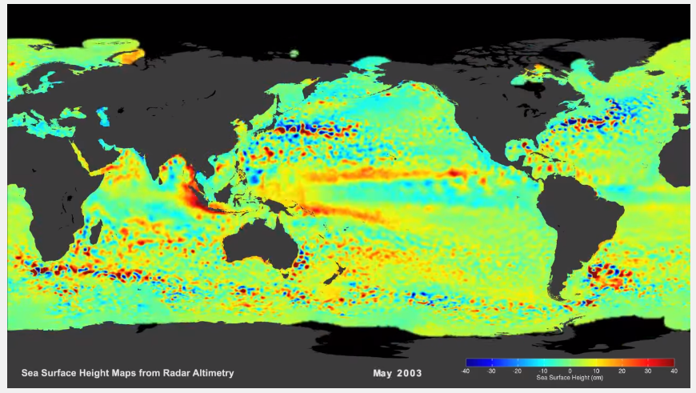
Sea surface height from space
https://www.youtube.com/watch?v=F8zYKb2GoR4
But can we see the Kuroshio Current in this movie? Why?

Slide 15
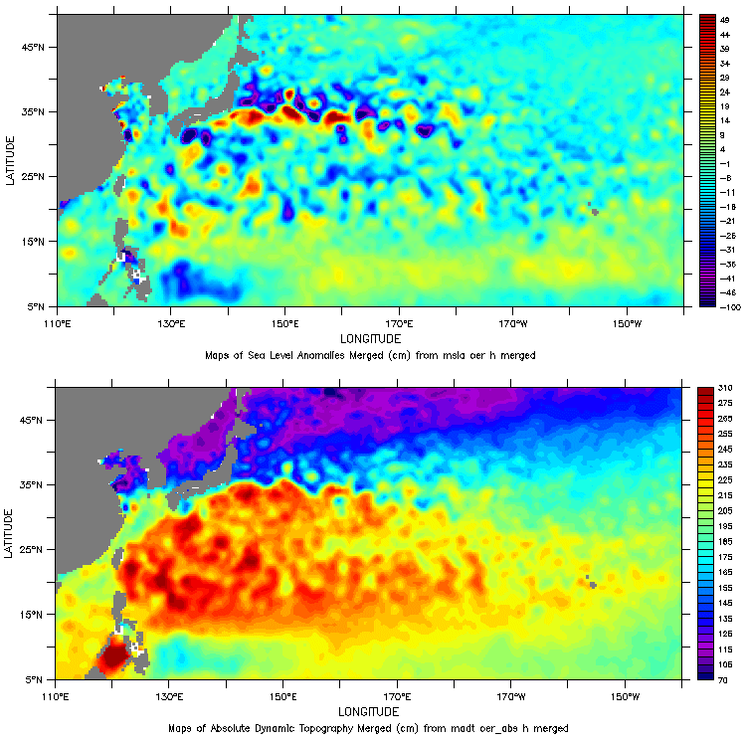
Satellite altimeter data
SLA (sea level anomaly: the variable part of sea surface height)
ADT (absolute dynamic topography: the sum of the variable part and of the constant part)

Slide 16
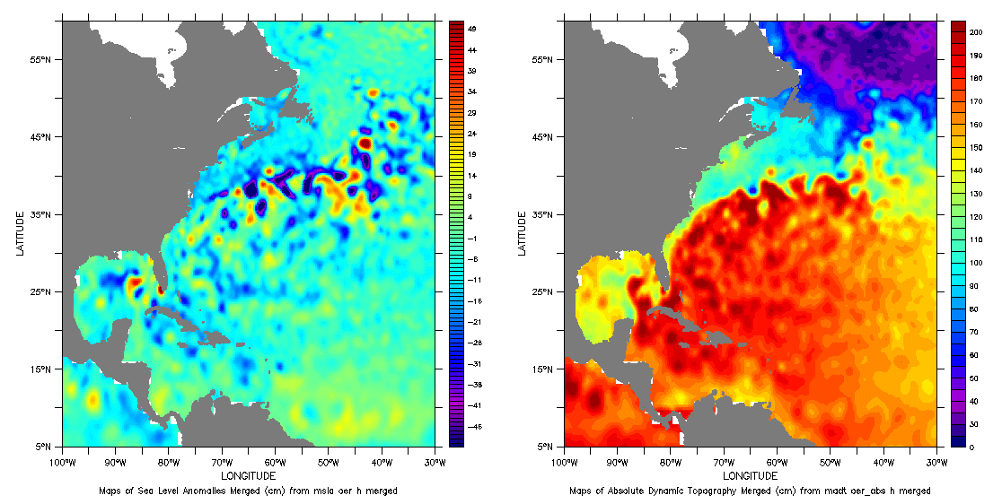
Satellite altimeter data
SLA (sea level anomaly)
ADT (absolute dynamic topography)

Slide 17
Exercise 1
Obtain data
Calculate the geostrophic velocities
Plot figures

Slide 18
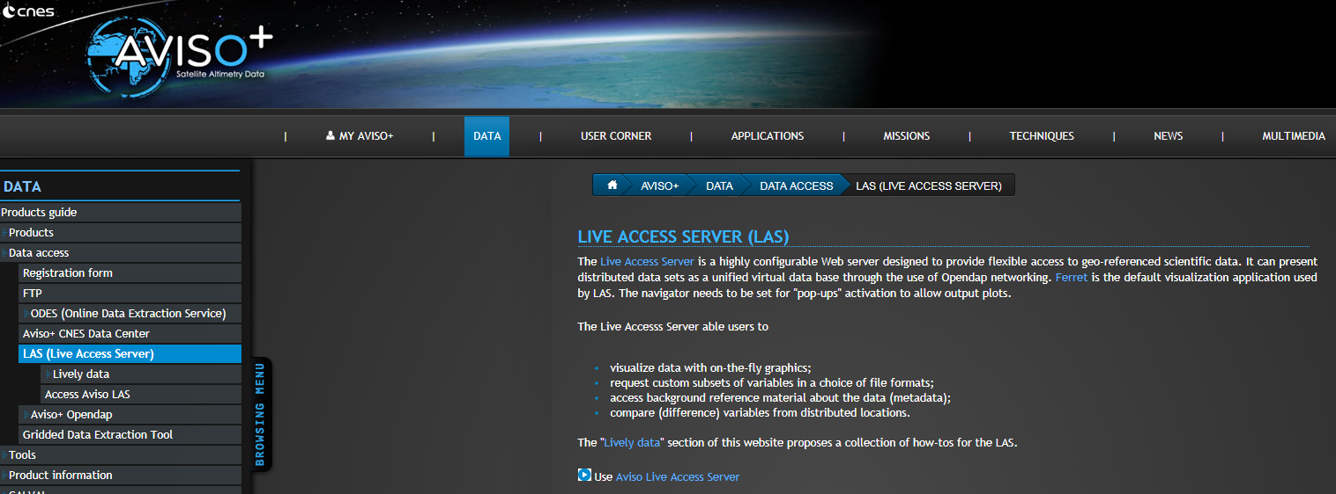
Satellite altimeter data from AVISO
Google Keywords: AVISO LIVE ACCESS SERVER

Slide 19
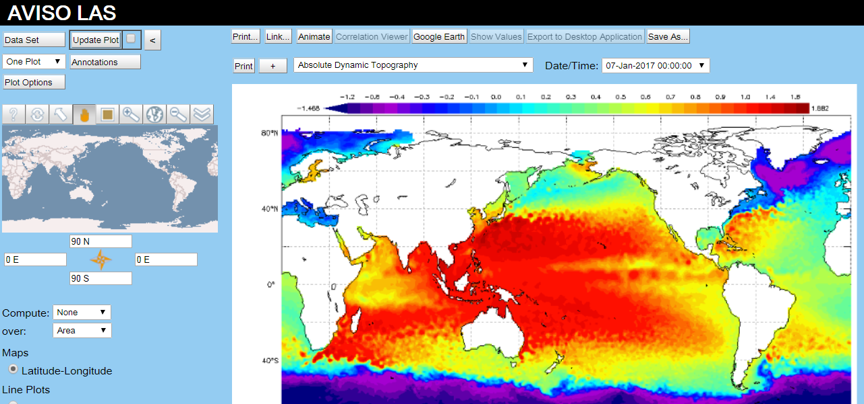
Satellite altimeter data from AVISO

Slide 20
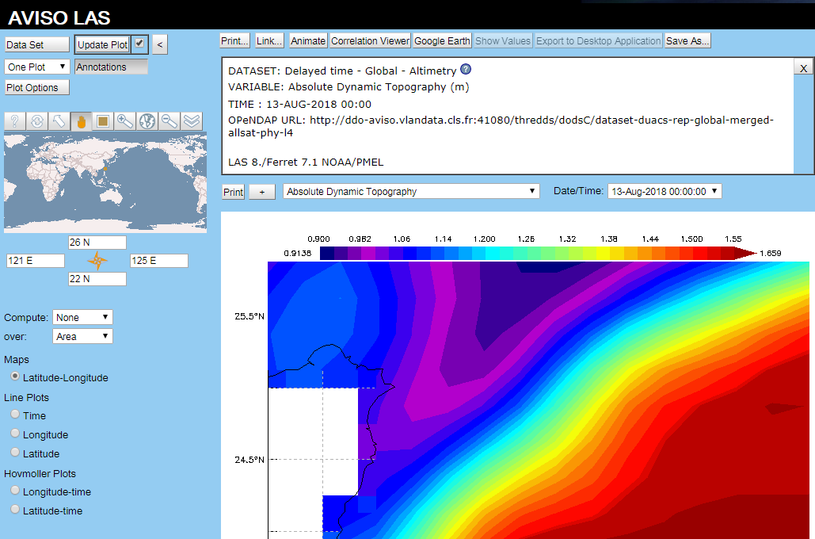
Demo (10~15 mins)

Slide 21
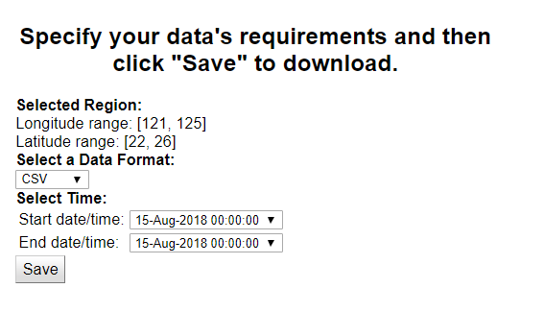
Download ASCII file
15th of August, 2018
Rename file to “20180815_adt.txt”

Slide 22
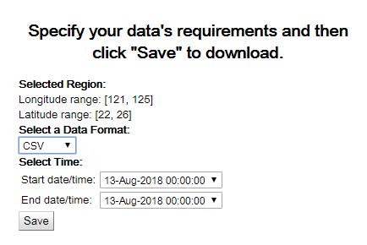
Download ASCII file
13th of August, 2018
Rename file to “20180813_adt.txt”

Slide 23
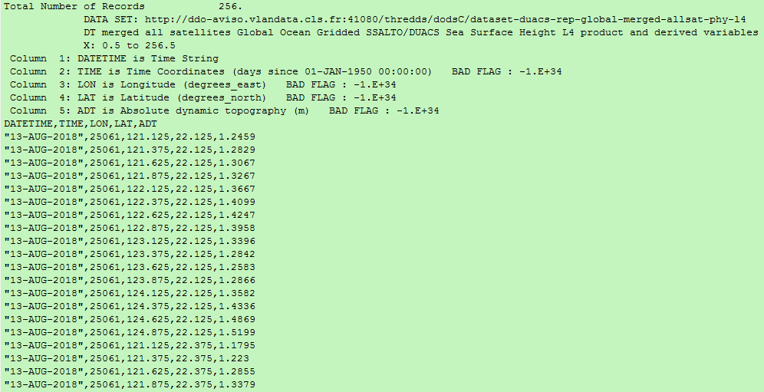
Viewing the data

Slide 24
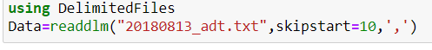
Skip the heading
filename='20180813_adt.txt';
fid = fopen(filename, 'r');
Data = textscan(fid, '%s %f %f %f %f', 'headerLines', 10,'Delimiter',',');
fclose(fid);
Data= cell2mat(Data(3:5));

Slide 25
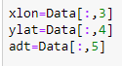
Set variables
xlon=Data(:,1);
ylat=Data(:,2);
adt=Data(:,3);
Check the size of these variables

Slide 26
Reshape variables and fix data on land
xlon=reshape(xlon,16,16); %% change size to: 16x16
ylat=reshape(ylat,16,16); %% change size to: 16x16
adt=reshape(adt,16,16); %% change size to: 16x16
I=find(adt<0);
adt(I)=NaN;
I=findall(adt.<0);
adt[I].=NaN;

Slide 27
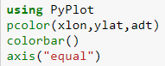
Plot ADT map
pcolor(xlon,ylat,adt); shading flat
axis equal
colorbar

Slide 28
Geostrophic Equations (height gradients)
Height → height gradients
4x4 data → 3x3 data

Slide 29
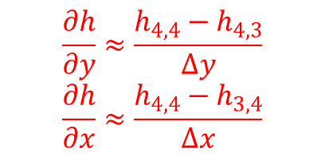
Geostrophic Equations (height gradients)
Height → height gradients
4x4 data → 3x3 data
using backward difference scheme (a numerical method)
(1,1)
(1,4)
x-direction
(3,4)
$$\frac{∂h}{∂y}≈\frac{h_{4,4}−h_{4,3}}{∆y}$$
$$\frac{∂h}{∂x}≈\frac{h_{4,4}−h_{3,4}}{∆x}$$
(4,1)
(4,4)
(4,3)
y-direction

Slide 30
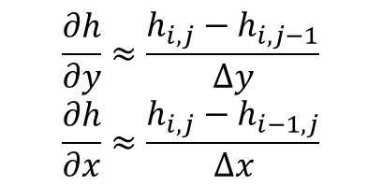
Geostrophic Equations (height gradients)
Height → height gradients
4x4 data → 3x3 data
using backward difference scheme (a numerical method)
(1,1)
(1,4)
x-direction, (i)
(3,4)
$$\frac{∂h}{∂y}≈\frac{h_{i,j}−h_{i,j−1}}{∆y}$$
$$\frac{∂h}{∂x}≈\frac{h_{i,j}−h_{i−1,j}}{∆x}$$
(4,1)
(4,4)
(4,3)
y-direction (j)

Slide 31
Geostrophic Equations (height gradients)
Height → height gradients
4x4 data → 3x3 data
using backward difference scheme (a numerical method)
(1,1)
(1,4)
x-direction, (i)
(3,4)
$$\frac{∂h}{∂y}≈\frac{h_{i,j}−h_{i,j−1}}{∆y}$$
$$\frac{∂h}{∂x}≈\frac{h_{i,j}−h_{i−1,j}}{∆x}$$
(4,1)
(4,4)
(4,3)
y-direction (j)

Slide 32
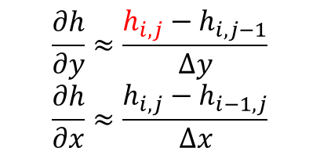
Geostrophic Equations (height gradients)
Height → height gradients
4x4 data → 3x3 data
using backward difference scheme (a numerical method)
(1,1)
(1,4)
x-direction, (i)
(3,4)
[2:end]
$$\frac{∂h}{∂y}≈\frac{h_{i,j}−h_{i,j−1}}{∆y}$$
$$\frac{∂h}{∂x}≈\frac{h_{i,j}−h_{i−1,j}}{∆x}$$
(4,1)
(4,4)
(4,3)
y-direction (j)

Slide 33
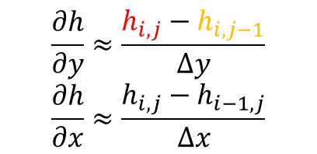
Geostrophic Equations (height gradients)
Height → height gradients
4x4 data → 3x3 data
using backward difference scheme (a numerical method)
(1,1)
(1,4)
x-direction, (i)
(3,4)
[2:end]
[1:end-1]
$$\frac{∂h}{∂y}≈\frac{h_{i,j}−h_{i,j−1}}{∆y}$$
$$\frac{∂h}{∂x}≈\frac{h_{i,j}−h_{i−1,j}}{∆x}$$
(4,1)
(4,4)
(4,3)
y-direction (j)

Slide 34
Geostrophic Equations (height gradients)
Height → height gradients
4x4 data → 3x3 data
using backward difference scheme (a numerical method)
(1,1)
(1,4)
x-direction, (i)
(3,4)
[2:end]
[1:end-1]
$$\frac{∂h}{∂y}≈\frac{h_{i,j}−h_{i,j−1}}{∆y}$$
$$\frac{∂h}{∂x}≈\frac{h_{i,j}−h_{i−1,j}}{∆x}$$
(4,1)
(4,4)
(4,3)
y-direction (j)

Slide 35
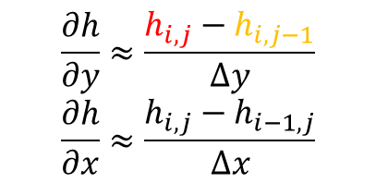
Geostrophic Equations (height gradients)
dx=0.25*110*1000; dy=0.25*110*1000;
%% Calculate the gradient of adt in x and y-dir
dhdy=(adt(:,2:end)-adt(:,1:end-1))/dy; %% size: 16x15
dhdx=(adt(2:end,:)-adt(1:end-1,:))/dx; %% size: 15x16
dhdy=dhdy(2:end,:); %% change size to: 15x15
dhdx=dhdx(:,2:end); %% change size to: 15x15
[i,j]
[:,2:end]
[:,1:end-1]
$$\frac{∂h}{∂y}≈\frac{h_{i,j}−h_{i,j−1}}{∆y}$$
$$\frac{∂h}{∂x}≈\frac{h_{i,j}−h_{i−1,j}}{∆x}$$

Slide 36
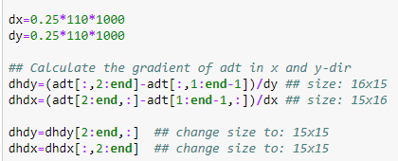
Geostrophic Equations (height gradients)
dx=0.25*110*1000; dy=0.25*110*1000;
%% Calculate the gradient of adt in x and y-dir
dhdy=(adt(:,2:end)-adt(:,1:end-1))/dy; %% size: 16x15
dhdx=(adt(2:end,:)-adt(1:end-1,:))/dx; %% size: 15x16
dhdy=dhdy(2:end,:); %% change size to: 15x15
dhdx=dhdx(:,2:end); %% change size to: 15x15
[i,j]
[:,2:end]
[:,1:end-1]
$$\frac{∂h}{∂y}≈\frac{h_{i,j}−h_{i,j−1}}{∆y}$$
$$\frac{∂h}{∂x}≈\frac{h_{i,j}−h_{i−1,j}}{∆x}$$

Slide 37
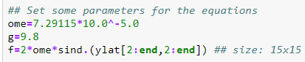
Geostrophic Equations (Set Parameters)
ome=7.29115*10^-5; g=9.8;
f=2*ome*sind(ylat(2:end,2:end)); %% size: 15x15

Slide 38
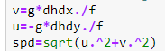
Geostrophic Equations (Calculate velocities and speeds)
v=g*dhdx./f;
u=-g*dhdy./f;
spd=sqrt(u.^2+v.^2);

Slide 39
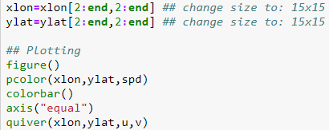
Show estimated speed (colors) and velocities (vectors) in a figure
xlon=xlon(2:end,2:end); %% change size to: 15x15
ylat=ylat(2:end,2:end); %% change size to: 15x15
figure
pcolor(xlon,ylat,spd);
shading flat
axis equal
colorbar
hold on
quiver(xlon,ylat,u,v,'k')

Slide 40
The figure to be plotted today

Slide 41
The figure to be plotted today (add in the coastline by yourself)

Slide 42
Homework 9 (due date: 2020/05/26)
Redo Exercise 1 but now using the ADT data on the 15th of January, 2018.
Add in the Taiwan coastline into the figures.
Compare the Kuroshio speed in winter and summer, based on the results obtained from this homework (2018/1/15 in winter) and from Exercise 1 (2018/8/13 in summer)
Is the Kuroshio faster in winter or in summer? Show and describe your proof.

